Slide 1
Causal Inference on the Impact of Financial Literacy on Financial Wellbeing
By: Roydan Cruz
Notes:
AI-generated content may be incorrect. --- This presentation explores the relationship between financial literacy and financial wellbeing using causal inference methods. We will discuss the business relevance, strategic impacts, machine learning approaches, and actionable insights drawn from the analysis.

Slide 2
Agenda Items
Introduction to the Challenge and Application Area
Societal Impact and Actionable Use Cases
Machine Learning Approach to Causal Inference
Introduction to the data and baseline modeling
Casual Inference results and interpretation
Notes:
We will begin with an introduction to financial wellbeing as a business priority and the role of financial literacy. Next, we will explore the strategic impact and use cases. Then, we will describe our machine learning approach to causal inference, followed by key results and business insights.

Slide 3
Introduction to the Challenge and Application Area
Notes:
Financial wellbeing is increasingly recognized as a critical business priority. Understanding financial literacy and its role is essential to closing current gaps and identifying opportunities to improve outcomes for clients and stakeholders.

Slide 4
Current challenges faced in financial theory
Microeconomic Theory – Life Cycle Hypothesis
Individuals are assumed to be well informed agents who optimize their saving and consumption patterns throughout wealth accumulation and deaccumulation phases.
The underlying assumption is that rational individuals are well informed and plan spending over their lifetimes, taking into account their future income (Hayes, 2025)
Financial Theory
Individuals collect and process all accessible information in a decision-making process to optimize their utility, well being, and profit.
Individuals have the capacity to continuously revise their current situation based on new information to maximize their utility (Sajid, Mushtaq, Murtaza, Yahiaoui, & Pereira, 2024)
Theoretical Limitation
Empirical evidence has shown that individuals do not practice rational decision making in various financial areas (Benartzi & Thaler, 2001)
Research continues to support that financial knowledge does positively contribute to financial decision-making and financial well-being.
Notes:
--- Financial wellbeing influences employee productivity, client satisfaction, and overall business performance. Organizations are prioritizing this to reduce risk and improve engagement and loyalty. Image source: Microsoft 365 content library

Slide 5

Defining Financial Literacy and Financial Well-being
Meaning of Financial Literacy and Financial Well-Being
Financial literacy is a combination of awareness, knowledge, skills, attitude, and behaviors necessary to make sound financial decisions and ultimately achieve individual financial well-being (Atkinson & Messy, 2011, p. 659).
Financial well-being is defined as a state where a person can fully meet current and ongoing financial obligations, feels secure about their financial future, and has the freedom to make choices that enhance their quality of life (CFPB, 2015, p. 18)
Importance in Decision-Making
Financial literacy improves individuals' ability to make informed financial decisions for better wellbeing.
Notes:
--- Financial literacy refers to the knowledge and skills that enable individuals to manage financial resources effectively. It is a key driver in improving financial decision-making and wellbeing. Image source: Microsoft 365 content library

Slide 6

Current Gaps and Opportunities for Improvement
Financial Literacy Gap
About a third of individuals in the US are not financially literate, based on the most recent National Financial Capabilities Survey
Financial Well-being Gap
Low financial literacy is severe in certain demographics, including low income individuals, those who have low education attainment, and women.
This may be attributed to the overall lower levels of financial literacy in these groups than their counterparts
Opportunity for Intervention
There is a strong need for targeted programs to improve financial literacy and overall financial wellbeing.
Notes:
--- Despite its importance, many individuals lack sufficient financial literacy. This gap presents opportunities for targeted interventions and program development to enhance financial wellbeing. Image source: Microsoft 365 content library

Slide 7
Societal Impact and Actionable Use Cases
Notes:
Understanding how financial literacy drives business outcomes allows organizations to design effective strategies and programs. We will examine benefits for various stakeholders and practical use cases.

Slide 8
How Financial Literacy Drives Key Policy-makers Outcomes
Better Decision making
Individuals who exhibit high financial literacy are likely to make wiser financial decisions, improving their financial well-being
This improved financial behavior has critical impacts at the macro and micro-level
Improved Savings Behavior
Financially literate individuals tend to save more consistently, contributing to their financial security and stability.
Individuals who display high levels of literacy are more likely to plan for retirement and accumulate much more wealth
Increased Participation in Financial Markets
Better understanding of financial services encourages greater interaction with financial securities and services. This can make individuals make optimal financial decisions depending on the economic environment.
At the microlevel informed individuals are less likely to be involved in sub-prime loans and have problems or default with them.
At the macroeconomic level improved financial behavior will limit the amount of individual involved with sub-prime loan which was a major contributing factor in the global financial crisis of 2008.
Example: During periods of high interest rates and inflation, individuals who display high financial literacy will be more likely to put a portion of their savings in a high yielding savings account or a CD.

Slide 9
Machine Learning Approach to Causal Inference
Notes:
We apply advanced machine learning techniques to rigorously assess whether financial literacy has a causal impact on financial wellbeing, using robust data sources and modeling methods.

Slide 10

General Casual Inference Framework
Identify:
The first step is identifying the treatment, confounders, and the outcome of interest.
Debiasing Step:
Regresses the treatment on the confounders to obtain the residuals of the treatment.
A. Treatment = function (Confounders)
B. Obtain Residuals
Denoising Step:
The outcome is regressed on the confounders to obtain the residuals
C. Outcome = function (Confounders)
D. Obtain Residuals
Outcome model:
Outcome residuals on the treatment residuals to obtain the average treatment effect
E. Outcome residual = function (Treatment Residuals)
F. ATE = Coefficient from step E
Casual inference and Frisch-Waugh-Lovell (FWL) theorem
Casual inference makes use of the general Frisch-Waugh-Lovell (FWL) theorem for debiasing. The framework essentially makes observational data appear as if it were generated from a randomized control trial.
The theorem states that multiple regression can be performed in a single stage or three separate stages (Subramanian, 2024)
Notes:
--- The central question is whether increasing financial literacy directly improves financial wellbeing, beyond simple correlations, by isolating causal effects through proper modeling. Image source: Microsoft 365 content library

Slide 11
Machine learing Casual Inference Framework
Identify:
The first step is identifying the treatment, confounders, and the outcome of interest.
Debiasing Step:
Regresses the treatment on the confounders to obtain the residuals of the treatment.
A. Treatment = function (Confounders)
B. Obtain Residuals
Denoising Step:
The outcome is regressed on the confounders to obtain the residuals
C. Outcome = function (Confounders)
D. Obtain Residuals
Outcome model:
Outcome residuals on the treatment residuals to obtain the average treatment effect
E. Outcome residual = function (Treatment Residuals)
F. ATE = Coefficient from step E
Double Machine Learning
Double machine learning references to utilizing two machine learning algorithms in the debiasing and denoising step to establish causality
Double Machine Learning with a Discrete Treatment
When the treatment is discrete, propensity score matching is utilized.
This is a procedure in which treated and untreated individuals are match based on similar conditional probabilities of receiving treatment.
The ATE is then extracted by comparing outcomes between the groups.
Notes:
--- The central question is whether increasing financial literacy directly improves financial wellbeing, beyond simple correlations, by isolating causal effects through proper modeling. Image source: Microsoft 365 content library

Slide 12
Introduction to the data and baseline modeling
Notes:
The findings demonstrate a strong causal relationship between financial literacy and improved wellbeing, providing actionable insights for decision-makers to optimize programs and strategies.

Slide 13

Description of Data Sources
Data Source
Utilize National Financial Capabilities Survey responses. The survey has over 100 questions spanning many different categories, creating a comprehensive financial profile of each respondent
Notes:
---The questionnaire provides basic demographic information about each respondent, insights into respondents' financial behaviors, information on attitudes towards financial institutions, insights into a respondent’s level of financial literacy, and much more We utilize diverse data including survey responses, transactional data, and demographic information, applying techniques such as propensity score matching and causal forests for inference. Image source: Microsoft 365 content library

Slide 14
Features Included
Features Included In the Analysis
Casual inference assumes that all factors that influence the outcome of interest (financial well-being) are included to partial out their effect on the outcome and treatment
Basic Demographic Information
Age
Gender
Marital status
Education level
Household income
Employment status
Ethnicity
Notes:
Casual inference assumes that all factors that influence the outcome of interest (financial well-being) are included to partial out their effect on the outcome and treatment. In this model, we include demographic information about participants, including their age, gender, marital status, education level, household income, employment status, and ethnicity (a binary variable of whether the participant is White Non-Hispanic). Additional controls were included inside the study to align with existing literature, including whether a household experienced an unexpected shock in income in the last 12 months, if a participant has any unpaid or resolved medical bills, home ownership, has a bank account, and if an individual received financial education in an educational institution or in the workplace where they were employed (Placeholder3). The participants' credit record was also included in the study for its perceived effect of influencing major financial outcomes (e.g., getting a loan) and thus overall financial well-being.
We utilize diverse data including survey responses, transactional data, and demographic information, applying techniques such as propensity score matching and causal forests for inference. Image source: Microsoft 365 content library

Slide 15
Description of Data Sources and Modeling Techniques
Additional Controls – Shocks and others
Health Shocks
Income Shocks
Credit record
3- Month Emergency Funds
Bank Acccount
Received financial education
Basic Demographic Information
Age
Gender
Marital status
Education level
Household income
Employment status
Ethnicity

Slide 16

Feature Engineering
Feature Engineering - Financial Wellbeing and Financial Literacy
Financial literacy is defined utilizing the “big three” financial literacy questions which were available in the NFCS. This definition was developed by Lusardi and Mitchell and measures knowledge of interest rates, inflation, and risk diversification. Respondents who answer all three questions are considered to be financially literate, and not otherwise.
Consumer Financial Protection Bureau have been made to create a consumer-driven definition of financial well-being. The NFCS employs an abbreviated version of this set of 10 questions, which will be utilized in this analysis.
The scale includes the following questions:
(1) “Because of my money situation, I feel like I will never have the things I want in life”
(2) “I am just getting by financially”
(3) “I am concerned that the money I have or will save won’t last”
(4) “I have money left over at the end of the month”
(5) “My finances control my life.”
Notes:
Financial literacy is defined utilizing the “big three” financial literacy questions which were available in the NFCS. This definition was developed by Lusardi and Mitchell and measures knowledge of interest rates, inflation, and risk diversification. Respondents who answer all three questions are considered to be financially literate, and not otherwise.
Consumer Financial Protection Bureau have been made to create a consumer-driven definition of financial well-being. The original scale includes 10 tested questions that allow practitioners and researchers to accurately and consistently quantify or observe an individual's well-being. The NFCS employs an abbreviated version of this set of 10 questions, which will be utilized in this analysis.

Slide 17
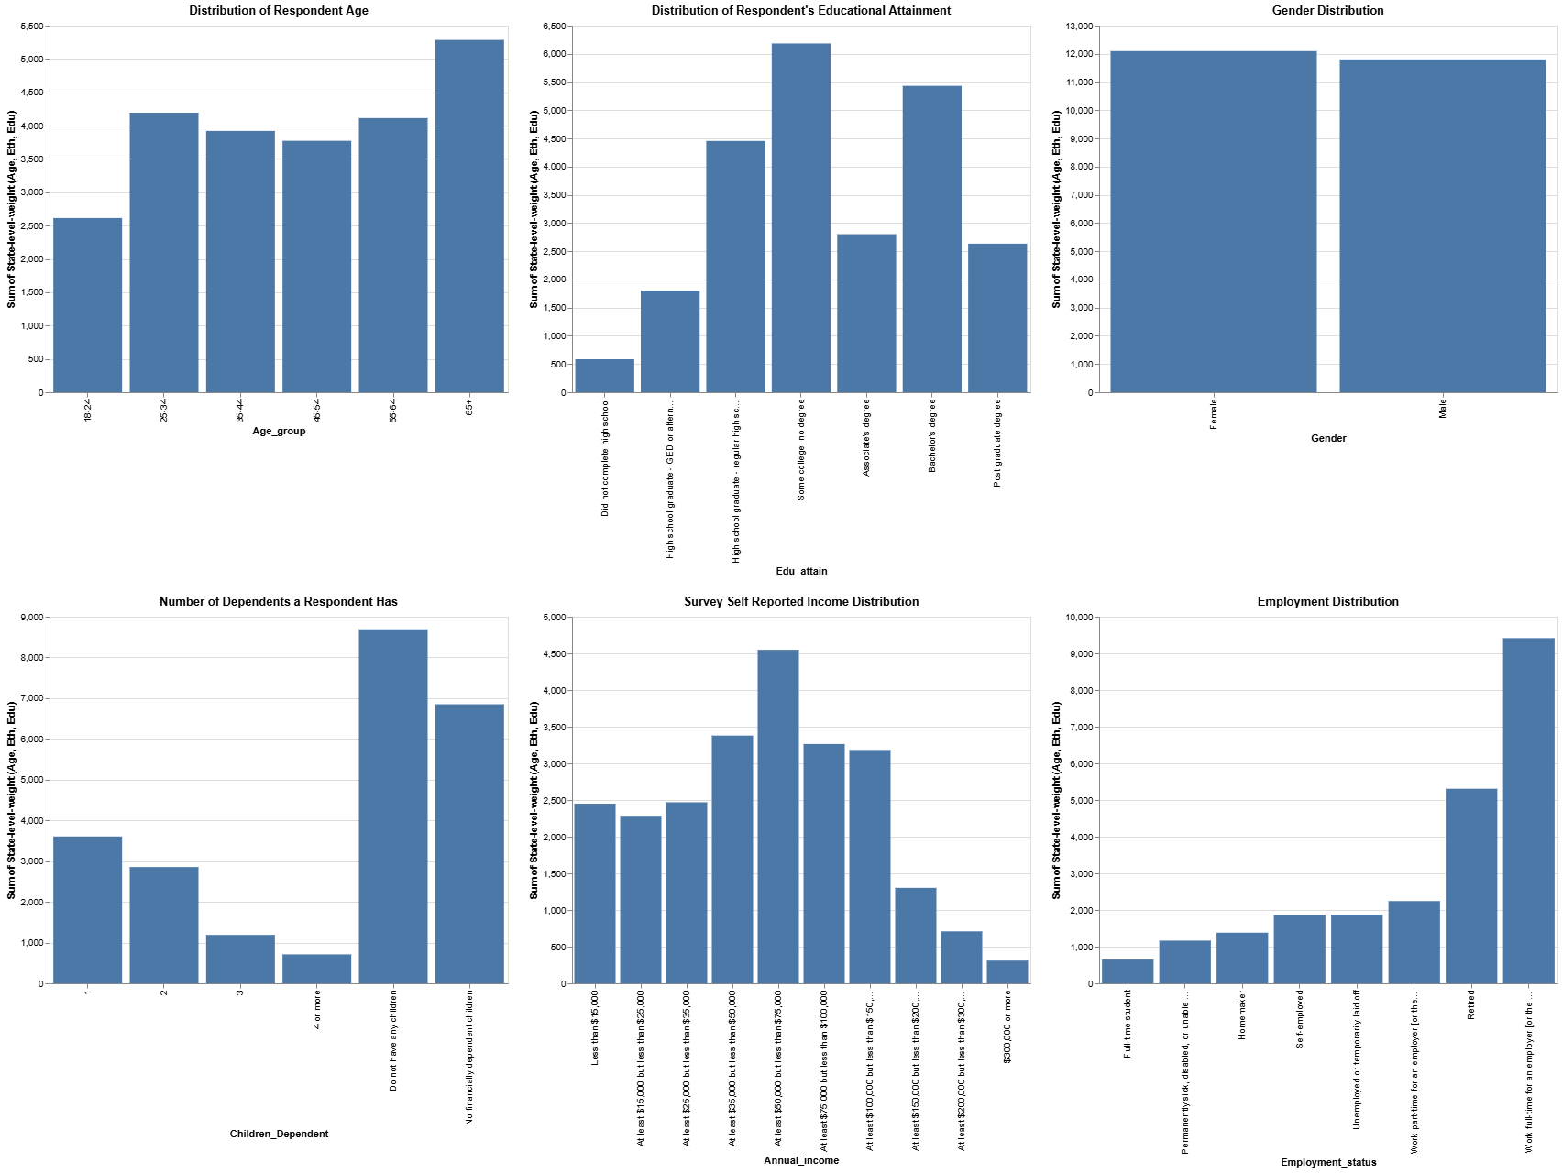
Exploratory Data Analysis
Notes:
Image source: Microsoft 365 content library Exploratory Data Analysis (EDA) helps understand data through visualizations and statistics. It reveals patterns, spot anomalies, and tests assumptions before formal modeling. EDA techniques include data summarization, outlier detection, and visualization tools like histograms, scatter plots, and box plots to guide further analysis.

Slide 18
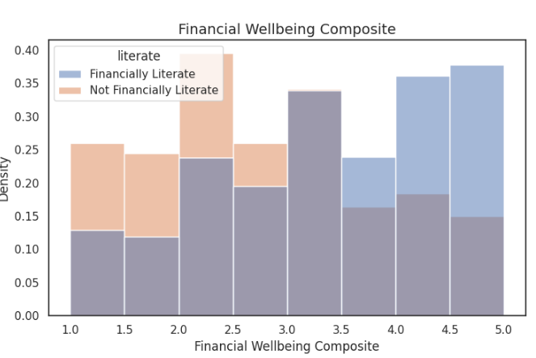
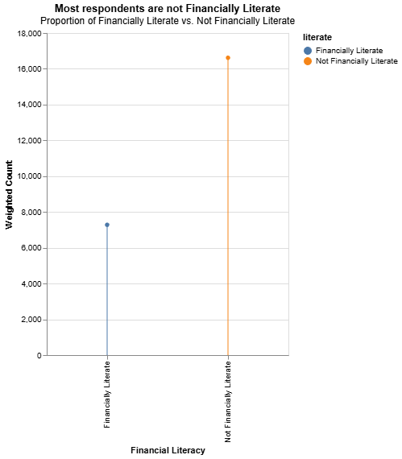
Exploratory Data Analysis
About 1/3 of respondents are financially literate
The density plot illustrates that financially literate individuals seem to follow a left-skewed distribution in that there is an increasing concentration of responses in higher levels of financial well-being.
Notes:
This corroborates the findings of the S&P Ratings Services Global Financial Literacy Survey that globally, about 2/3 of individuals are not financially literate.

Slide 19
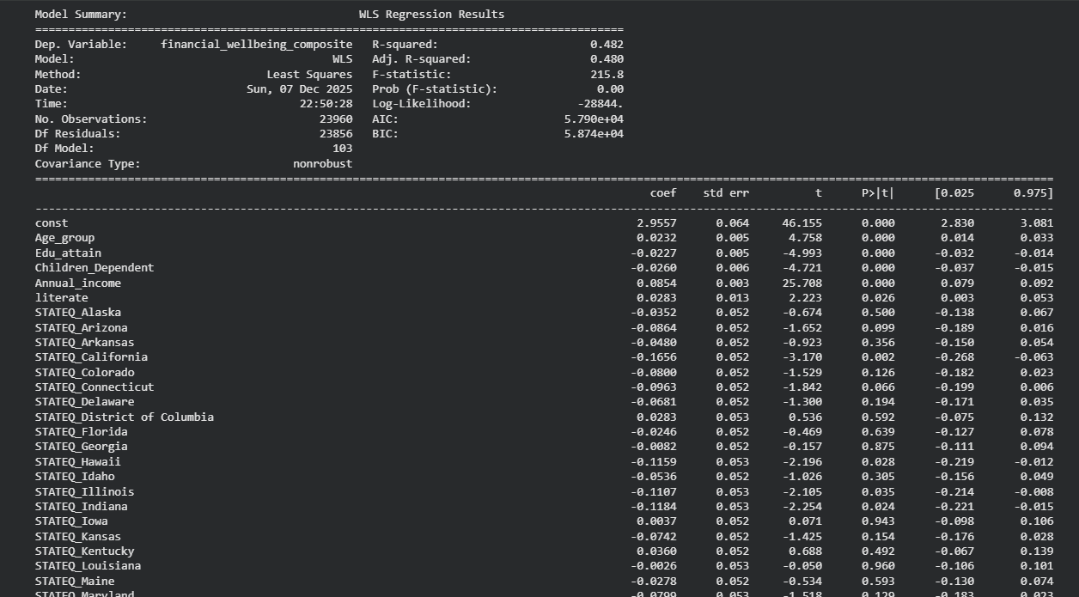
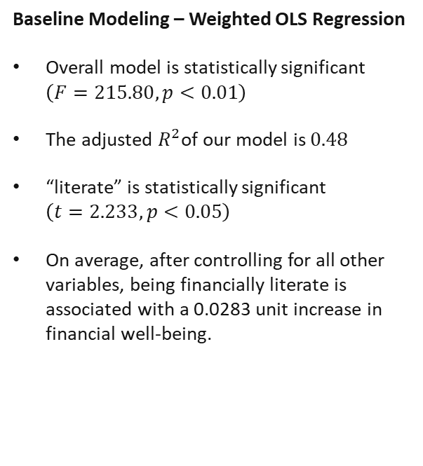
Baseline Modeling
Baseline Modeling – Weighted OLS Regression
Overall model is statistically significant $\left(F=215.80,p<0.01\right)$
The adjusted $R^{2}$of our model is $0.48$
“literate” is statistically significant $\left(t=2.233,p<0.05\right)$
On average, after controlling for all other variables, being financially literate is associated with a 0.0283 unit increase in financial well-being.
Notes:
---The questionnaire provides basic demographic information about each respondent, insights into respondents' financial behaviors, information on attitudes towards financial institutions, insights into a respondent’s level of financial literacy, and much more We utilize diverse data including survey responses, transactional data, and demographic information, applying techniques such as propensity score matching and causal forests for inference. Image source: Microsoft 365 content library

Slide 20
Casual Inference

Slide 21
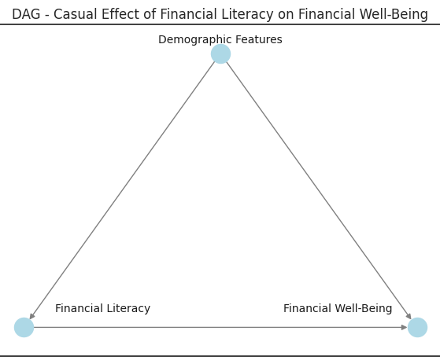
Approach to Measuring Impact Using Causal Inference
Estimating Treatment Effect
Our method calculates the average treatment effect of financial literacy on wellbeing to measure impact precisely.
Controlling Confounders
We control for confounders to isolate the true causal relationship between financial literacy and wellbeing.
Ensuring Robustness and Validity
Robustness checks and validation techniques ensure the reliability of causal conclusions.
Notes:
--- Our approach estimates the average treatment effect of financial literacy on wellbeing, controlling for confounders and ensuring robustness and validity of the causal conclusions. Image source: Microsoft 365 content library

Slide 22
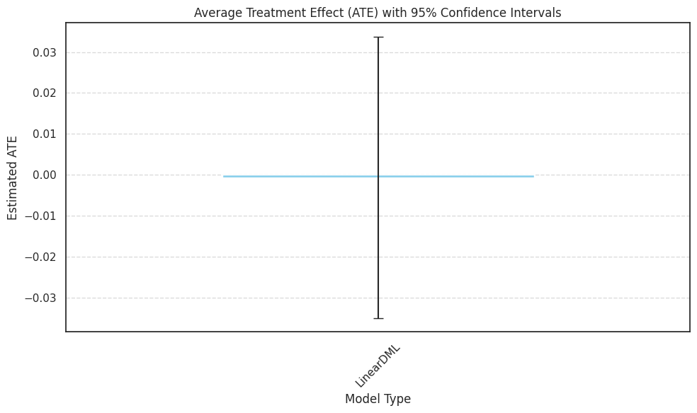
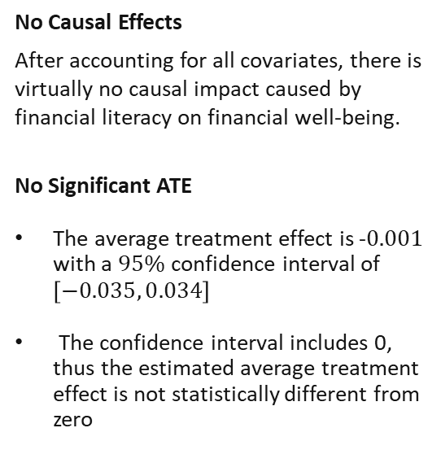
Key Findings: Strength of Causal Relationship
No Causal Effects
After accounting for all covariates, there is virtually no causal impact caused by financial literacy on financial well-being.
No Significant ATE
The average treatment effect is -$0.001$ with a $95\%$confidence interval of $\left[−0.035, 0.034\right]$
The confidence interval includes 0, thus the estimated average treatment effect is not statistically different from zero
Notes:
--- Analysis reveals significant positive causal effects of financial literacy on multiple dimensions of financial wellbeing, confirming the value of investing in literacy initiatives. Image source: Microsoft 365 content library

Slide 23

Interpretation for Decision-Making
Insights From Modeling
Financial literacy likely plays a pivotal role in financial well-being, although other factors may have to be considered.
Our causal analysis suggests that financial literacy likely does not have a causal effect on financial well-being
Other Influential Factors on Financial Well-being – Financial Confidence
Recent research by Muhammad Sajid and others found a strong positive impact of financial literacy and financial confidence on financial well-being with the moderating effect of financial behaviors
Notes:
This suggests that financial well-being is not solely a factor of absolute financial knowledge, but rather a combination of the confidence to act upon this knowledge, shaping an individual's financial behaviors to seek the optimal balance of consumption, saving, and investing for their current financial situation.

Slide 24
Conclusion
Importance of Financial Literacy
Financial literacy is an essential aspect for improving individual financial wellbeing
Role of Causal Inference
Causal inference suggests that the drivers of financial well-being are more complex. It may involve financial confidence and financial literacy mediating through financial behavior to change an individual's financial well being.

Slide 25
Works Cited
Fonseca, R., Mullen, K. J., Zamarro, G., & Zissimopoulos, J. (2012). What Explains the Gender Gap in Financial Literacy? The Role of Household Decision Making. Journal of Consumer Affairs, 90-106.
Hayes, A. (2025, April 21). Investopedia. Retrieved from Investopedia: https://www.investopedia.com/terms/l/life-cycle-hypothesis.asp
Keith, T. Z. (2015). Multiple Regression and Beyond. 188-191.
Sajid, M., & al, e. (2024). Financial literacy, confidence and well-being: The mediating role of financial behavior. ELSEVIER.
Sajid, M., Mushtaq, R., Murtaza, G., Yahiaoui, D., & Pereira, V. (2024). Financial literacy, confidence and well-being: The mediating role of financial behavior. sciencedirect.
Subramanian, A. (2024, September 30). Causal Inference — Double Machine Learning.

Slide 26
Appendix

Slide 27
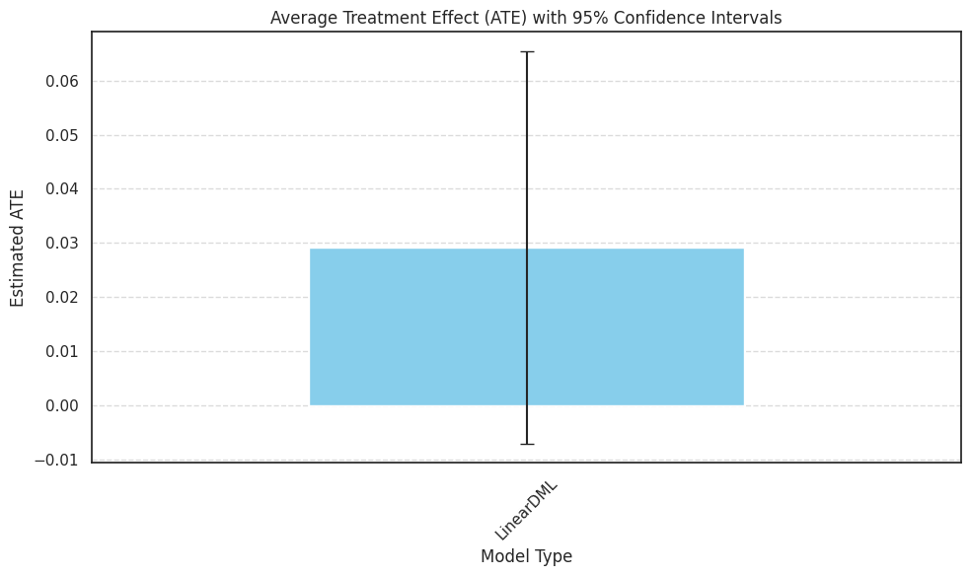
Sensitivity Analysis
ATE Change by Removing 3-Month Emergency Funds
By removing “Emergency_funds_3_month_xxx” features, we discover a favorable increase in the ATE
The ATE has switched signs and now reports a value of 0.29, matching the regression coefficient from our OLS model.
Omitted Variable bias
This shows the impact of what omitted variable bias can cause, and why it I crucial when working with causal models to include all theorized confounders that affect both the treatment and the outcome of interest
Notes:
--- Analysis reveals significant positive causal effects of financial literacy on multiple dimensions of financial wellbeing, confirming the value of investing in literacy initiatives. Image source: Microsoft 365 content library

Slide 28
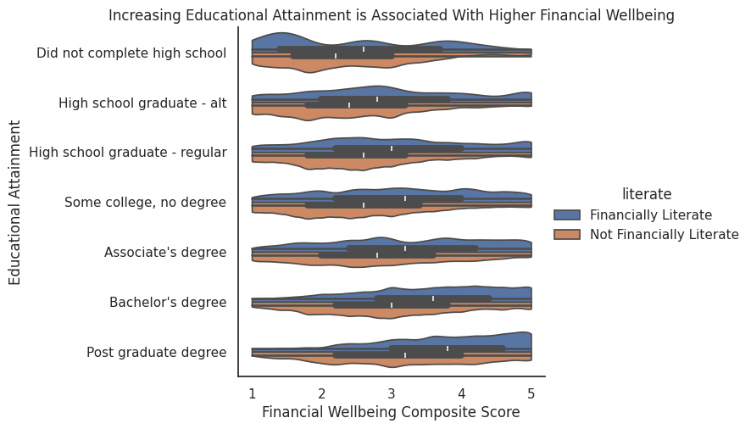
Exploratory Data Analysis
Reviewing the financial well-being composite metric, the density plot illustrates that financially literate individuals seem to follow a left-skewed distribution in that there is an increasing concentration of responses in higher levels of financial well-being.
Focusing on the treatment groups, we find that for both groups, increasing educational attainment virtually always increases the median financial well-being scores.
Notes:
Image source: Microsoft 365 content library Exploratory Data Analysis (EDA) helps understand data through visualizations and statistics. It reveals patterns, spot anomalies, and tests assumptions before formal modeling. EDA techniques include data summarization, outlier detection, and visualization tools like histograms, scatter plots, and box plots to guide further analysis.

